Slide 1



Crop Disease Detection and Soil Analysis
Department : Information Technology
Group ID: 18
Group Members:
1. Shreeraj Rane (16010420086)
2. Surin Shah (16010420087)
3. Mayur Bhore (16010420090)
4. Shreyas Panchikattil (16010420096)
Group Mentor:
Prof. Chirag Desai

Slide 2

Problem Definition
This project aims to develop a computer vision-based website that can automate the identification of diseases in maize cultivation. The objective is to provide farmers with an efficient and accurate tool to protect their crops and minimize potential losses.
Additionally, the project proposes the use of machine learning algorithms to estimate agricultural output, which can assist farmers in selecting suitable crops based on soil type and weather conditions.
The website aims to provide a user-friendly portal that offers farmers a one-stop-shop for information about crop selection and soil type, facilitating informed decision-making.
Ultimately, the project aims to improve crop yield and increase profitability for farmers by providing them with advanced technology and data-driven insights.

Slide 3
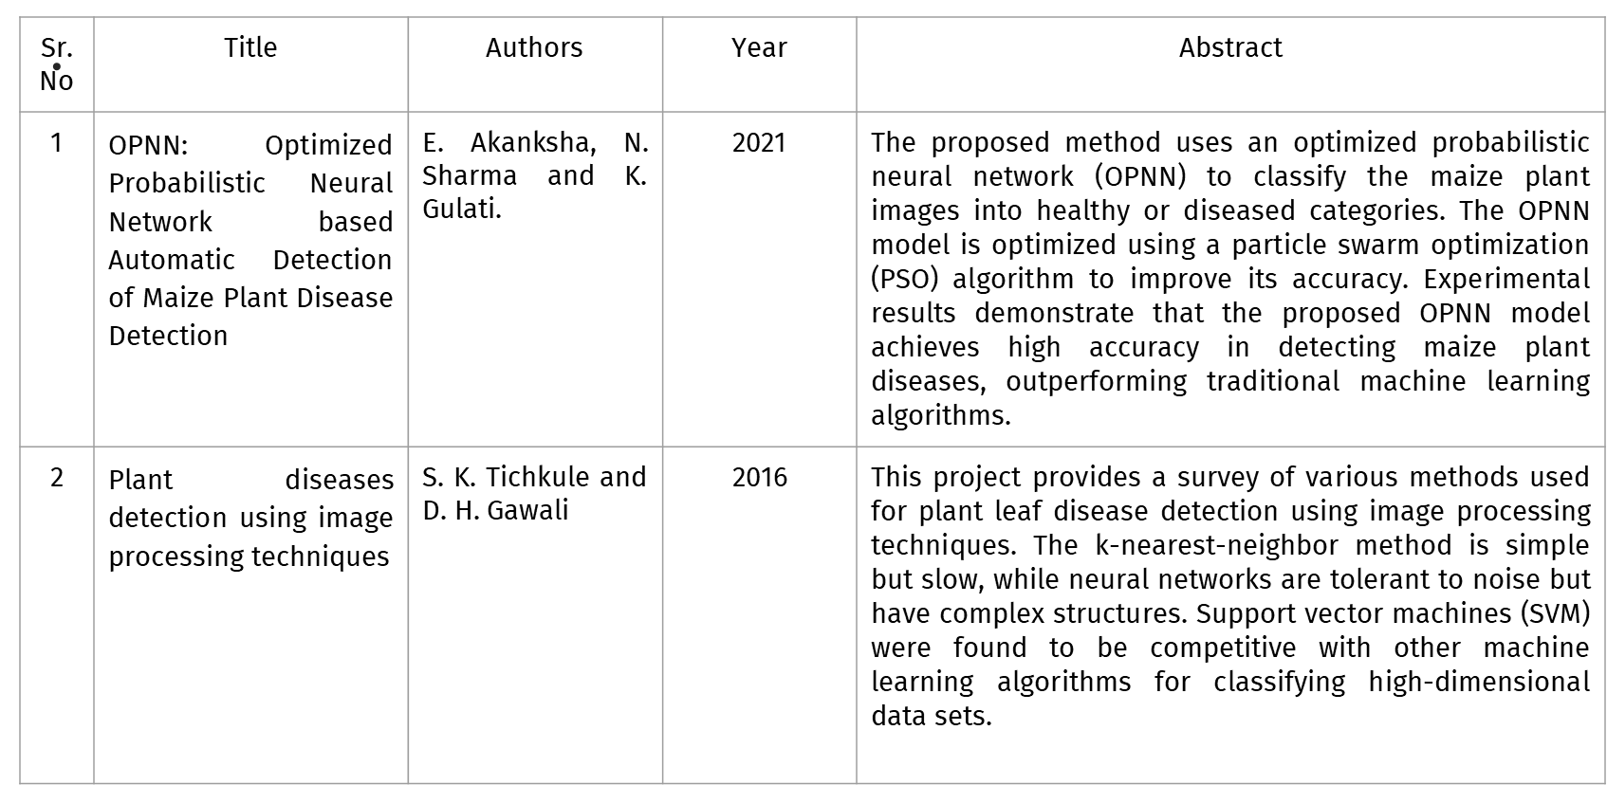
Background Work

Slide 4
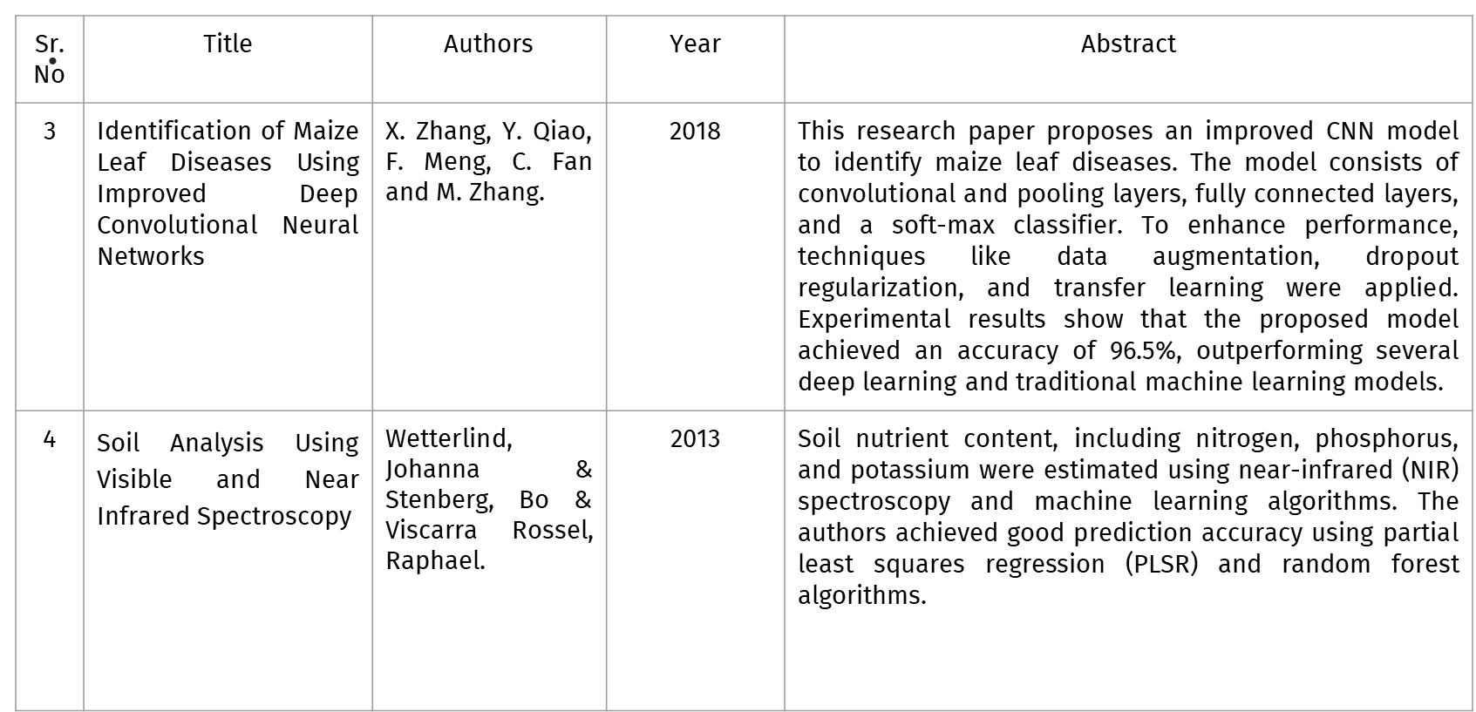
Background Work

Slide 5
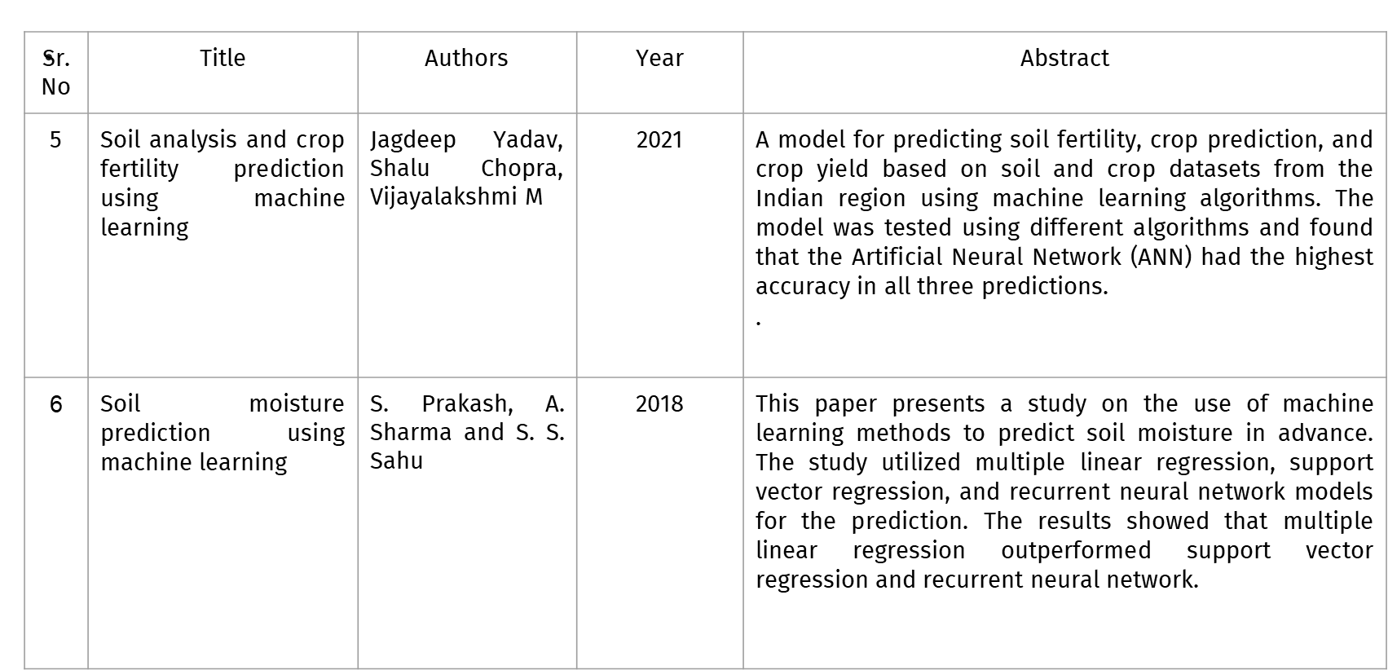
Background Work

Slide 6



Scope (Functional Requirements)
Disease Detection and Diagnosis
Customized Treatment Options
Smarter Crop Selection
The website should be able to analyze images of crops and accurately identify the presence of diseases.
The website should be able to provide information on the type of disease identified and recommend appropriate treatment options.
The website should provide farmers with information on crop selection based on soil type and weather conditions.

Slide 7





Scope (Non-Functional Requirements)
Security and Privacy
Scalability and Performance
Cross-Platform Compatibility
The website should be secure and protect the privacy of users.
The website should be able to handle a large volume of data and user requests without experiencing downtime or performance issues.
The website should be accessible from different devices and platforms.
Speed and Responsiveness
Easy Maintenance
The website should be fast and responsive to ensure a seamless user experience.
The website should be easy to maintain and update, with minimal downtime required for maintenance activities.

Slide 8
Data Set Description
The Maize and Corn Disease dataset, available on Kaggle, contains images of healthy maize and corn plants, as well as plants infected with four different diseases: Gray Leaf Spot, Common Rust, Northern Leaf Blight, and Healthy. The dataset consists of a total of 4,000 images, with 1,000 images for each class. The images were collected from different regions in Uganda, Africa. The dataset can be used for developing and testing machine learning models for the detection and classification of maize and corn diseases.
Link:https://www.kaggle.com/datasets/smaranjitghose/corn-or-maize-leaf-disease-dataset
The dataset is about precision agriculture and aims to help farmers make informed decisions about the most suitable crops to grow in a particular farm based on various parameters. The dataset includes parameters such as N, P, and K, which are ratios of Nitrogen, Phosphorous, and Potassium content in the soil, as well as temperature, humidity, pH value of the soil, and rainfall in millimeters. The data was built by augmenting datasets of rainfall, climate, and fertilizer data available for India.
Link: https://www.kaggle.com/datasets/atharvaingle/crop-recommendation-dataset

Slide 9









Technology used
Python/OpenCV
HTML, CSS, JS
Flask
JQuery
Node Js
React

Slide 10
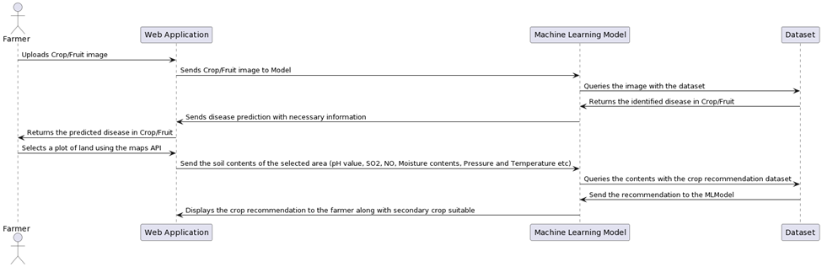
Overview of Implementation- Input and output of the system, Block Diagram/Work Flow Diagram/ Module Diagram

Slide 11
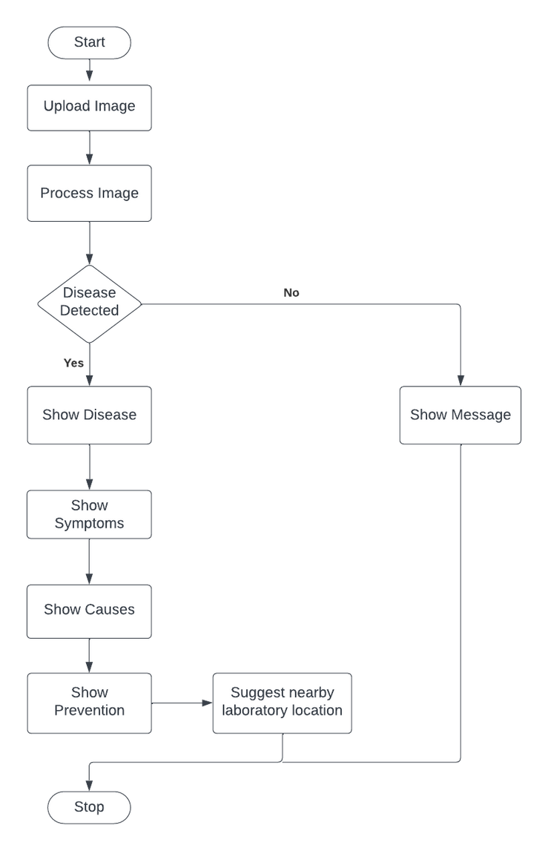
Crop Disease Detection System Flowchart

Slide 12
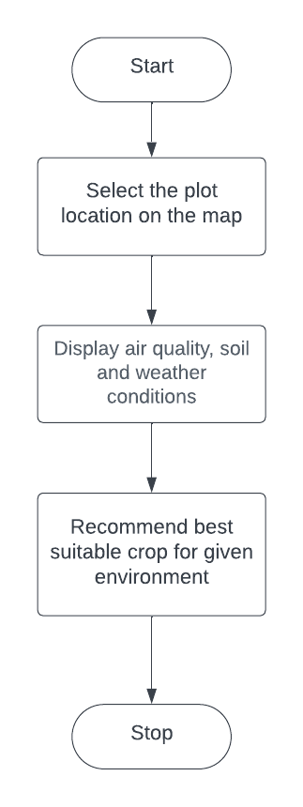
Soil Analysis Flowchart

Slide 13
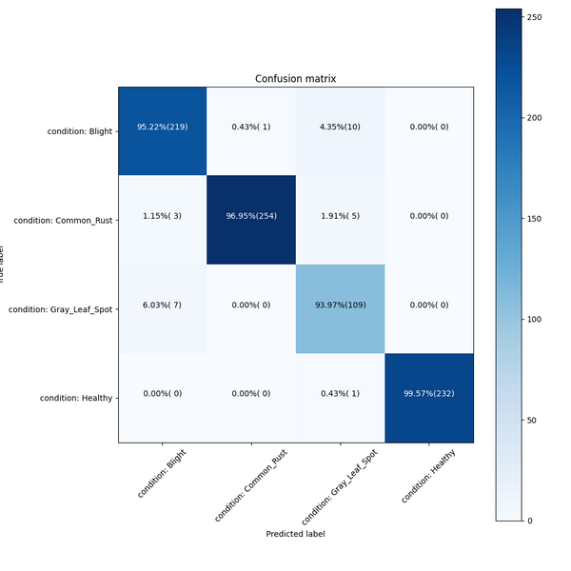
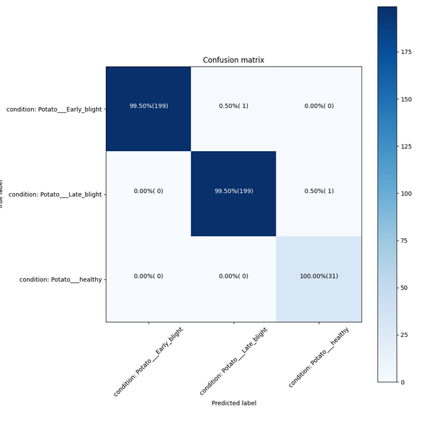
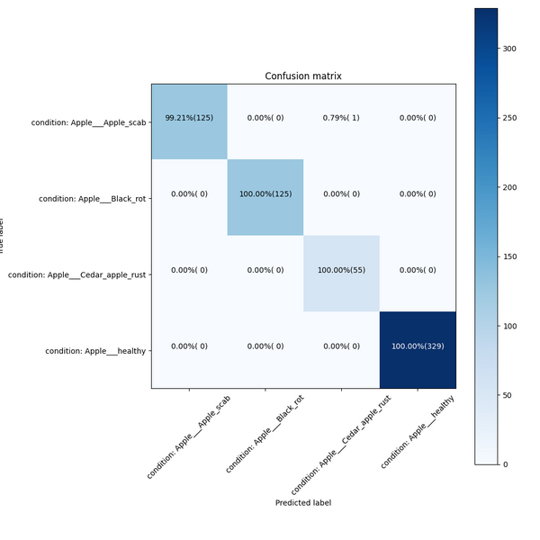
Result and Discussion
Accurate detection of crop diseases: The machine learning model has been taught to identify numerous diseases that affect the maize crop and fruits. To analyze crop imagery and display the results appropriately, we used computer vision. The model's high level of recall and precision enables farmers to make quick corrections.
Corn/Maize
Potato
Apple

Slide 14
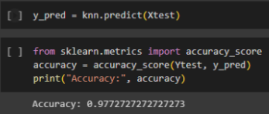
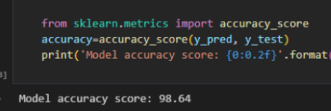
Result and Discussion
Soil analysis recommendations: The technology can recommend farmers on the best crops to plant on a particular area of land. The advice will be based on a number of factors, including the amount of soil moisture, the air quality index, the pH level, the presence of particular chemicals, etc. Farmers will have a range of options that, given the conditions, are suited for growing a variety of crops.
We Compared two algorithms we tested which were KNN and Gradientboost Machine
KNN Accuracy = 97.72%
Gradientboost machine
Accuracy = 98.64%

Slide 15
Conclusion
The project of designing a computer vision-based website that automates disease identification in maize cultivation and using machine learning to estimate agricultural output has the potential to revolutionize the way farmers manage their crops, improve food security, and contribute to sustainable agriculture.
The development of this website has several benefits, such as reducing the time and cost associated with traditional disease diagnosis methods, enabling timely and appropriate actions to protect crops, providing farmers with valuable information on crop selection and soil type, and improving agricultural output and profitability.

Slide 16
Learning
In terms of learning, this project highlights the power of computer vision and machine learning in addressing real-world problems and how technology can be harnessed for the greater good. The project also underscores the importance of user-centered design, security, scalability, cross-platform compatibility, speed, and easy maintenance in building a successful and sustainable website.
Overall, this project can serve as a blueprint for developing similar applications in other areas of agriculture, healthcare, and other industries, where technology can be used to solve complex problems and improve people's lives.

Slide 17

Implementation schedule of Mini-Project across Sem VI
18th March - 30th March
Frontend and Model Development for disease detection feature
16th April - 23rd April
Backend Development and Testing
1st April - 15th April
Frontend and Model Development for Crop Recommendation feature
10th Feb - 7th March
Data gathering and Preprocessing

Slide 18
Thank You!!!

